Slide 1


TRAFFIC SIGN RECOGNITION
Guide by :- Kushal Sharma
Group 3
Group Members : Sneha Hashilkar
Pranali Karawade
Gaurang Sonkavde
Pritam Naik

Slide 2
Content
Introduction
Problem Statement
Aim
Proposed Solution
Architecture
Implementation
Result
Output

Slide 3
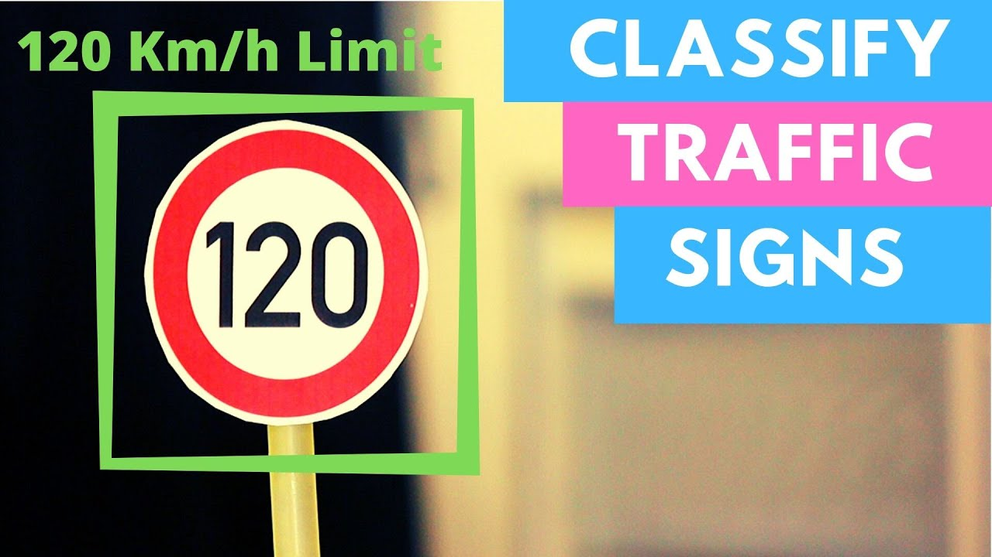
INTRODUCTION
This is an attempt to make a self learning system that can itself understand and interpret the meaning of new traffic signs.

Slide 4
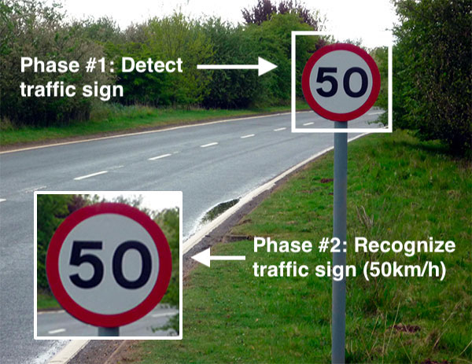
Problem Statement
● To propose a method to extract the image frames
● To propose a method to remove the effect of the different illuminations on extracted image frames.
● To propose an algorithm to identify the regions of interest
● To propose a method to extract the symbol of the traffic warning sign
● To propose a method to identify the symbol of the traffic warning sign

Slide 5

aim
An automatic TSDR system can detect and recognise traffic signs from and within images captured by cameras or imaging sensors.
In adverse traffic conditions, the driver may not notice traffic signs, which may cause accidents. In such scenarios, the TSDR system comes into action.

Slide 6
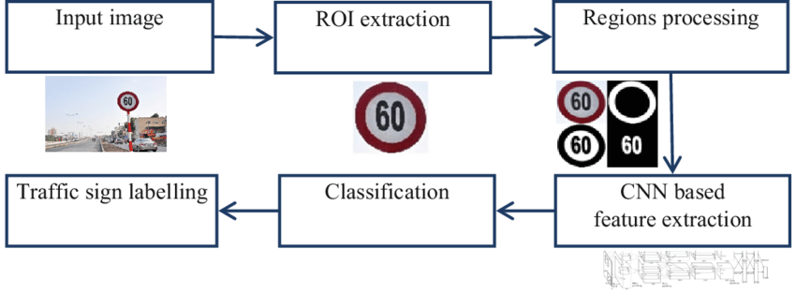
Proposed system

Slide 7

architecture

Slide 8

Impementation
Importing libraries
Reading Input Images
Build the Model
Train the Model
Displaying the Accuracy and Loss Values
Predicting the Test Data
Accuracy
GUI Representation

Slide 9
Result
Displaying the Accuracy and Loss Values

Slide 10
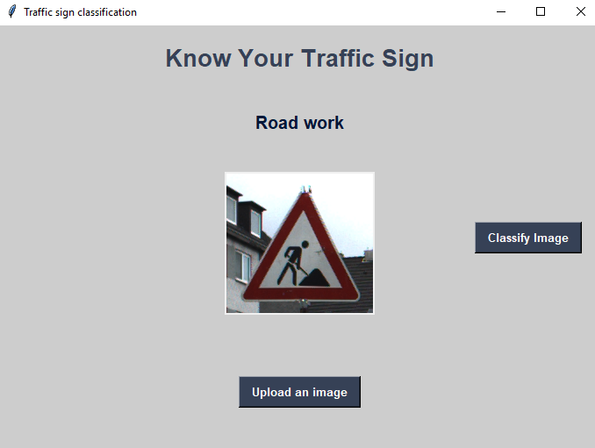
output

Slide 11


